Slide 1


SWIFF: Space Weather Integrated Forecasting Framework
Coordinator: Giovanni Lapenta
Centrum voor Plasma-Astrofysica
Katholieke Universiteit Leuven
BELGIUM
Swiff.eu

Slide 2





New FP7 project on space weather modelling
Science Lead | Participant short name | Participant organisation name | Country
Coordinator:G. Lapenta | KU Leuven | Katholieke Universiteit Leuven | Belgium
V. Pierrard | BISA | Belgian Institute for Space Aeronomy | Belgium
F. Califano | UNIPI | Università di Pisa | Italy
A. Nordlund | UCPH | Københavns Universitet | Denmark
A. Bemporad | OATO | Astronomical Observatory Turin - Istituto Nazionale di Astrofisica | Italy
P. Travnicek | ASI | Astronomical Institute, Academy of Sciences of the Czech Republic | Czech Republic
C. Parnell | USTAN | University of St Andrews | Scotland, UK

Slide 3
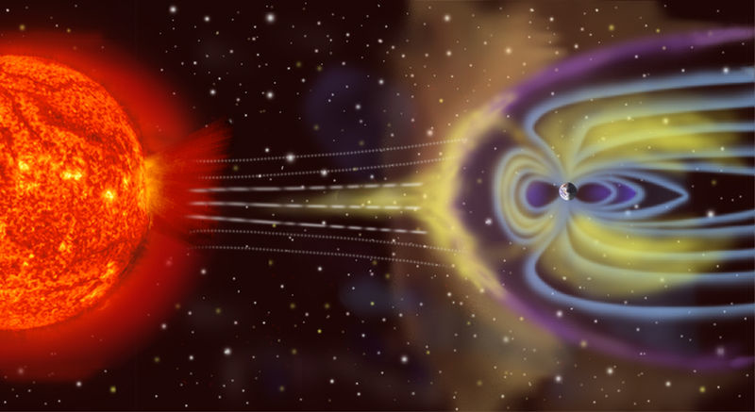
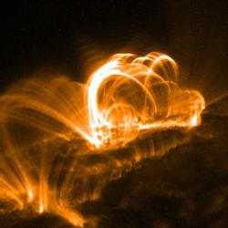
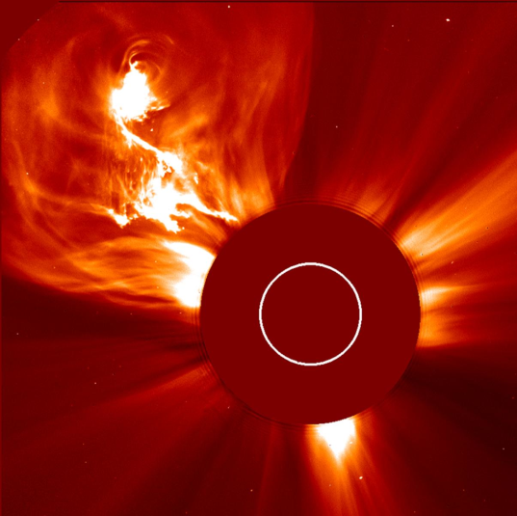
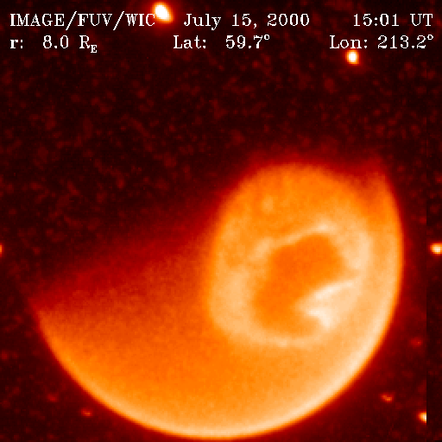
Fundamental challenge of space weather modelling: multiple phyiscs
ionosphere
solar environment
magnetotail
interplanetary plasmas, dust...
magnetosphere
sun-to-earth sun-effect propagation
polar cusps
3
TRACE September 2005
LASCO September 2002
IMAGE July 2000

Slide 4
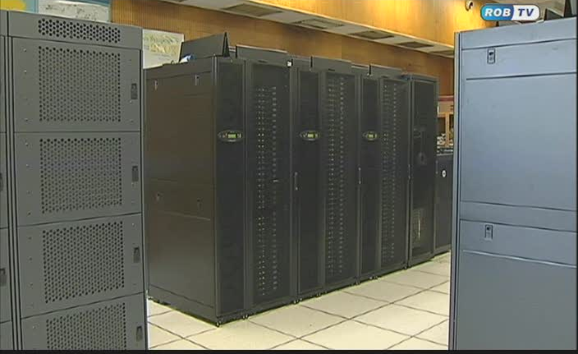

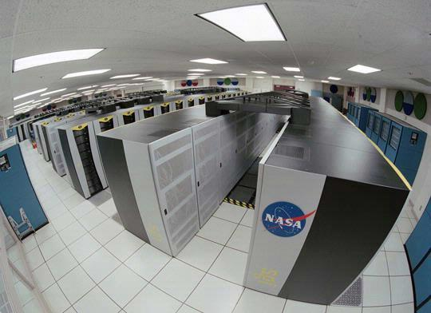
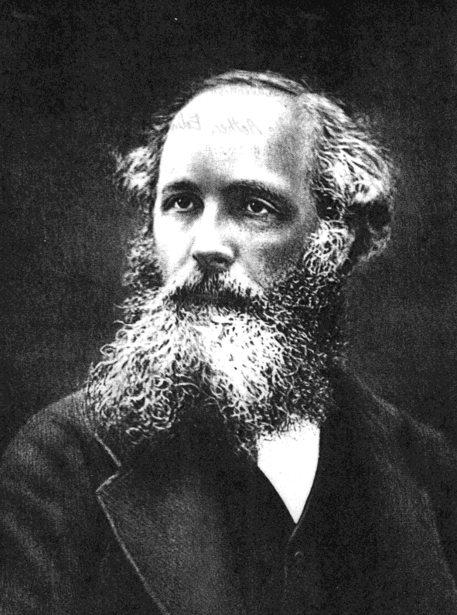
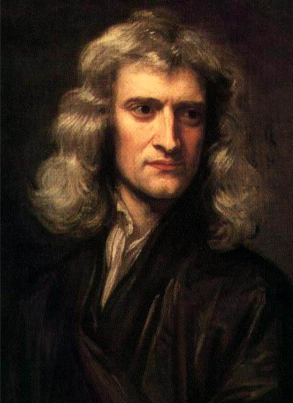
High performance computer simulation of space weather
KU Leuven
Physics-based forecasting
Bring space weather to the current state of weather modelling
Prepare mathematical and software infrastructure
Most advanced computer facilities and numerical simulation methods

Slide 5
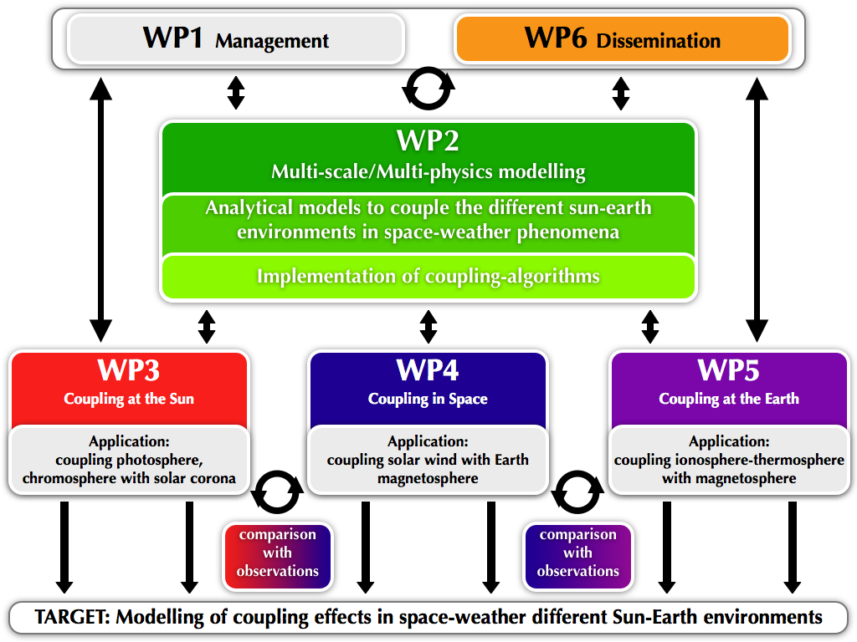
New FP7 project on space weather modelling

Slide 6
OUR APPROACH
State of the Art
Goal of Swiff
10⁶ km
hours
FLUID
SYSTEM
scales
10⁵ km
1 m
10³ km
1 s
ION scales
10² km
10⁻³ s
10⁰ km
10⁻⁴ s
ELECTRON
scales
KINETIC
10⁻¹ km
10⁻⁵ s
SWIFF allows to bridge the micro-macro gap by using new methods to couple fluid and kinetic physics

Slide 7
Fundamental challenge of space weather modeling: multiple physics
WP3: couling at the Sun (Nordlund)
WP4: coupling in space (Califano)
WP5: coupling at the Earth (Pierrard)
WP1/6: Management and Dissemination (Lapenta)
WP2: Mathematical Models (Keppens)
7

Slide 8

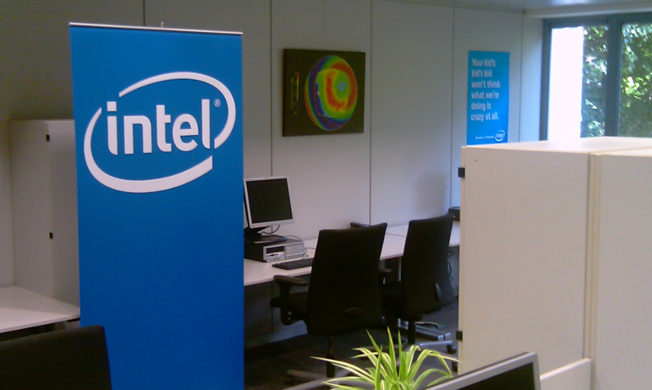

INTEL ExaScience Lab in Leuven
June 8, 2010
New Lab to Develop Solar Flare Prediction as Driver for Intel’s Future Exascale Supercomputers
Intel, imec and Five Flemish Universities Open Flanders ExaScience Lab
exascience.com
Position available relative
to space weather

